Slide 1
AVIATION VENTURE RISK ANALYSIS
NZEVES GROUP PLC

Slide 2
overview
This presentation derives its data from the cleaned_Aviation_data.csv whose original source is the USA National Transportation Safety Board. This presentation focuses to give an analysis of the aircraft accidents with a view to show the aircraft whose accident impact would be minimal.
Problem Definition
Our company is expanding in to new industries to diversify its portfolio. Specifically, they are interested in purchasing and operating airplanes for commercial and private enterprises, but do not know anything about the potential risks of aircraft. I am charged with determining which aircrafts are the lowest risk for the company to start this new business endeavor. These findings shall be translated into actionable insights that the head of the new aviation division can use to help decide which aircraft to purchase.

Slide 3
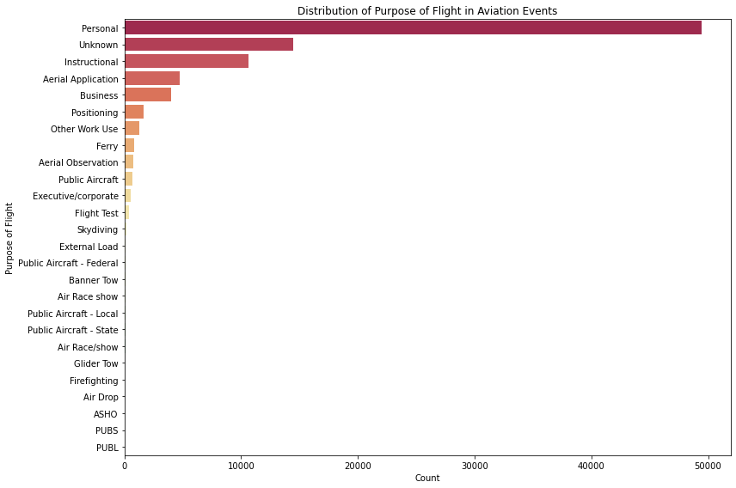
Data Analysis and Visualization The below graph shows the distribution of aircrafts involved in accidents by purpose.

Slide 4
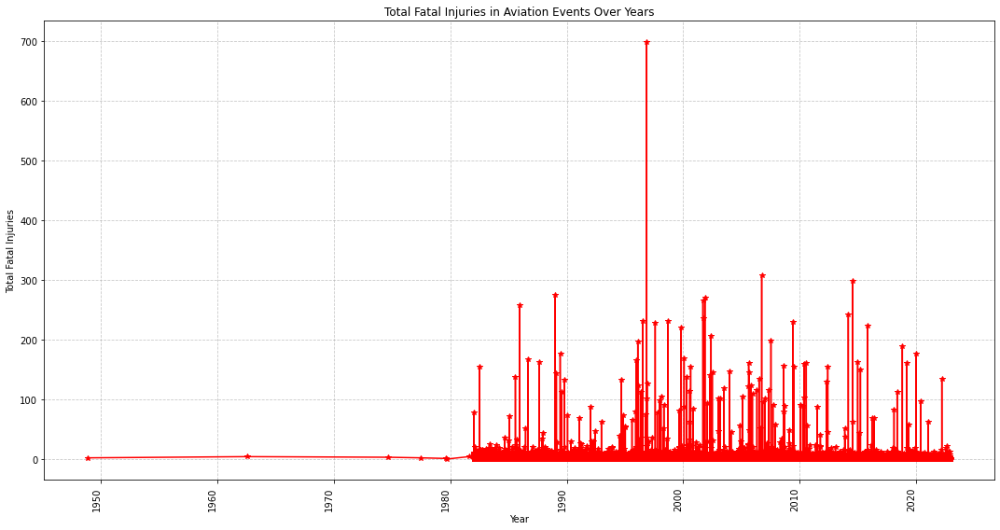
Analysis of Total Fatal Injuries over the years

Slide 5
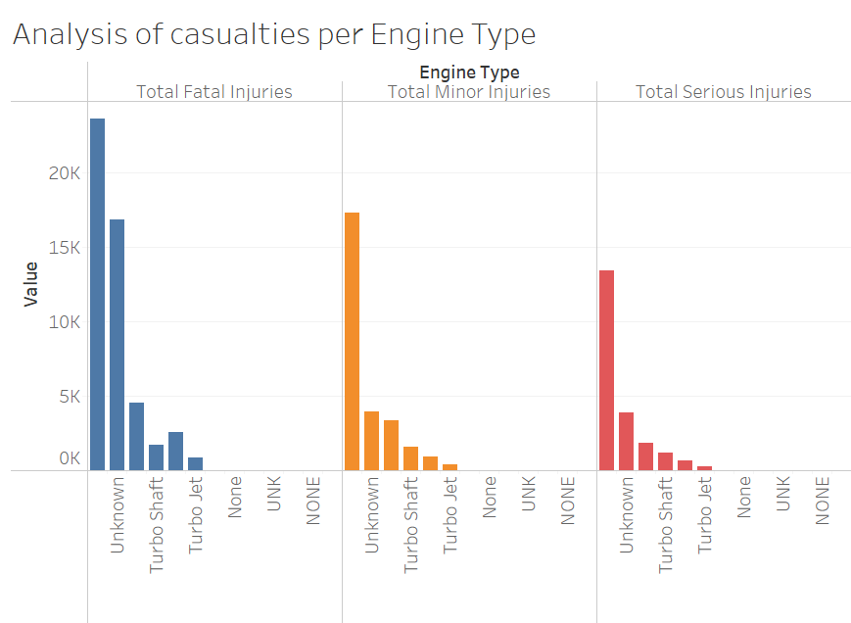

Slide 6
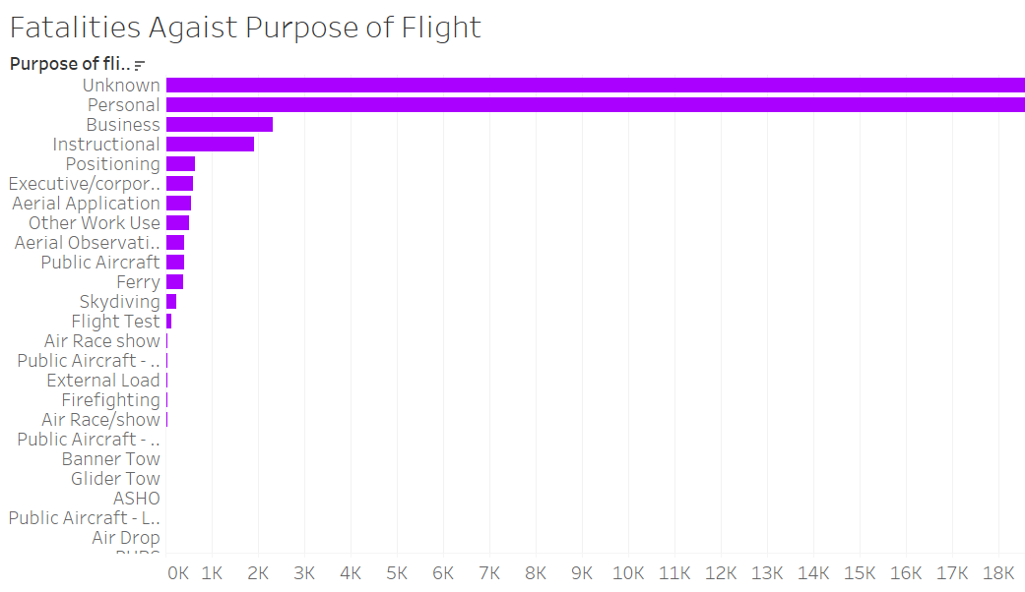

Slide 7
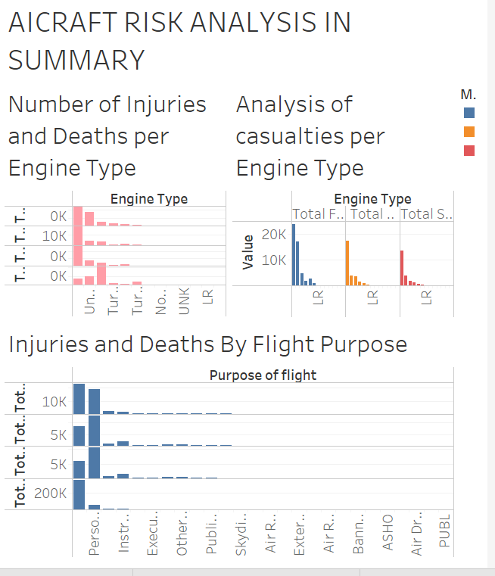

Slide 8
Observations Summary
Personal aircraft accidents take the bigger proportion for aircraft accidents reported.
2. The number of reported aircraft accidents remained low until the year 1950 when the started to rise.

Slide 9
Recommendations
1. The company should consider purchasing an aircraft whose with the least number of reported accident cases. In this case, based on the analysis made, Honda aircraft has been observed to be the aircraft with the least cases of accidents reported.
2. Aircrafts fitted with reciprocating engine type have the high number of fatal injuries reported whenever an accident occurred.
While making a choice of the aircraft by engine, the management should avoid aircrafts with this type of engine.
3. There is also need to do further analysis using other statistical measures to analyse whether there could be any correlations between weather conditions and number of accidents reported and as well as its effect to number of injuries.

